Slide 1
Inverse Matrix
S. J. Hahn

Slide 2
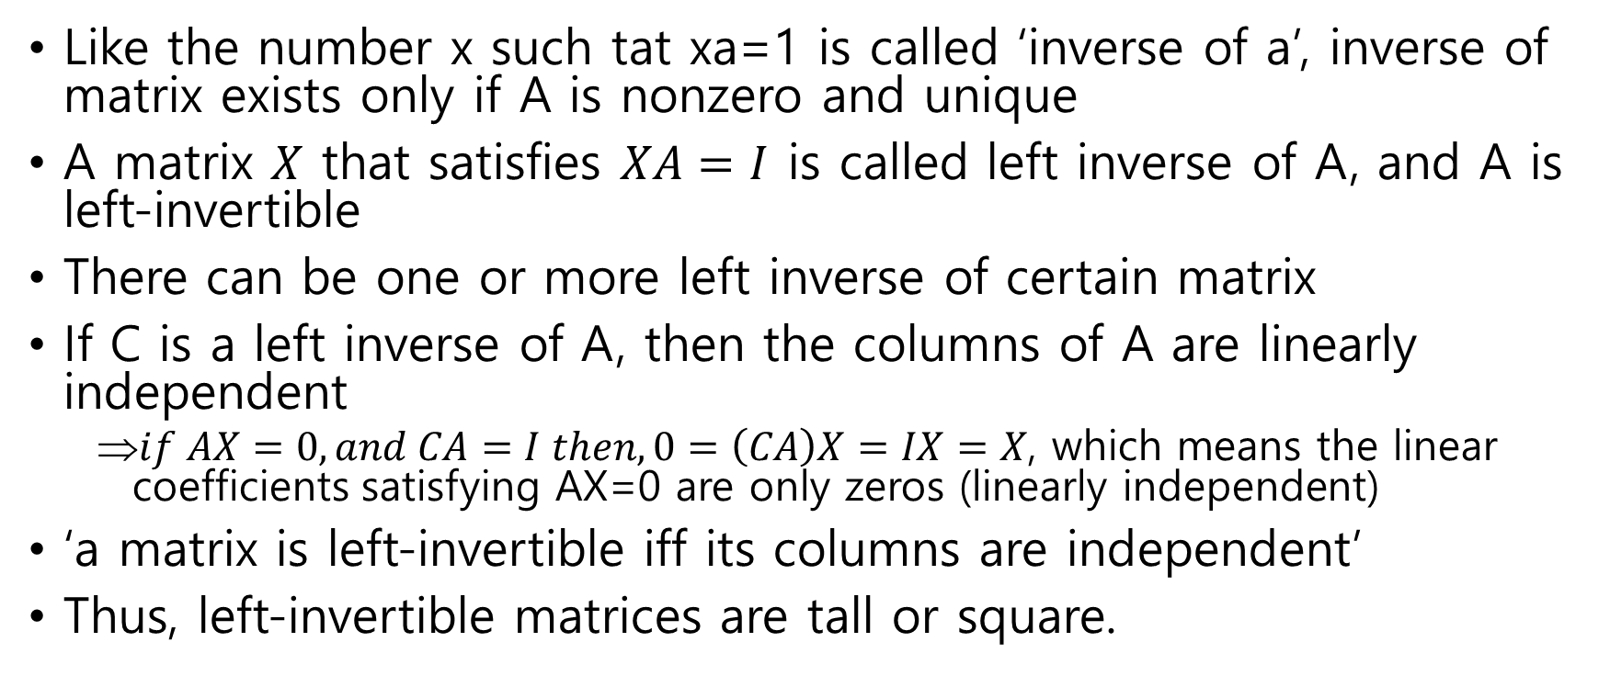
Left Inverses
Like the number x such tat xa=1 is called ‘inverse of a’, inverse of matrix exists only if A is nonzero and unique
A matrix $X$ that satisfies $XA=I$ is called left inverse of A, and A is left-invertible
There can be one or more left inverse of certain matrix
If C is a left inverse of A, then the columns of A are linearly independent
$if AX=0, and CA=I then, 0=\left(CA\right)X=IX=X$, which means the linear coefficients satisfying AX=0 are only zeros (linearly independent)
‘a matrix is left-invertible iff its columns are independent’
Thus, left-invertible matrices are tall or square.

Slide 3
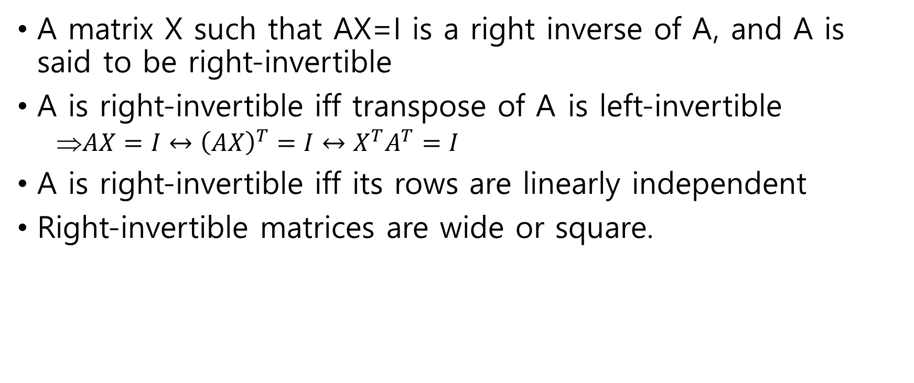
Right Inverses
A matrix X such that AX=I is a right inverse of A, and A is said to be right-invertible
A is right-invertible iff transpose of A is left-invertible
$AX=I↔{\left(AX\right)}^{T}=I↔X^{T}A^{T}=I$
A is right-invertible iff its rows are linearly independent
Right-invertible matrices are wide or square.

Slide 4
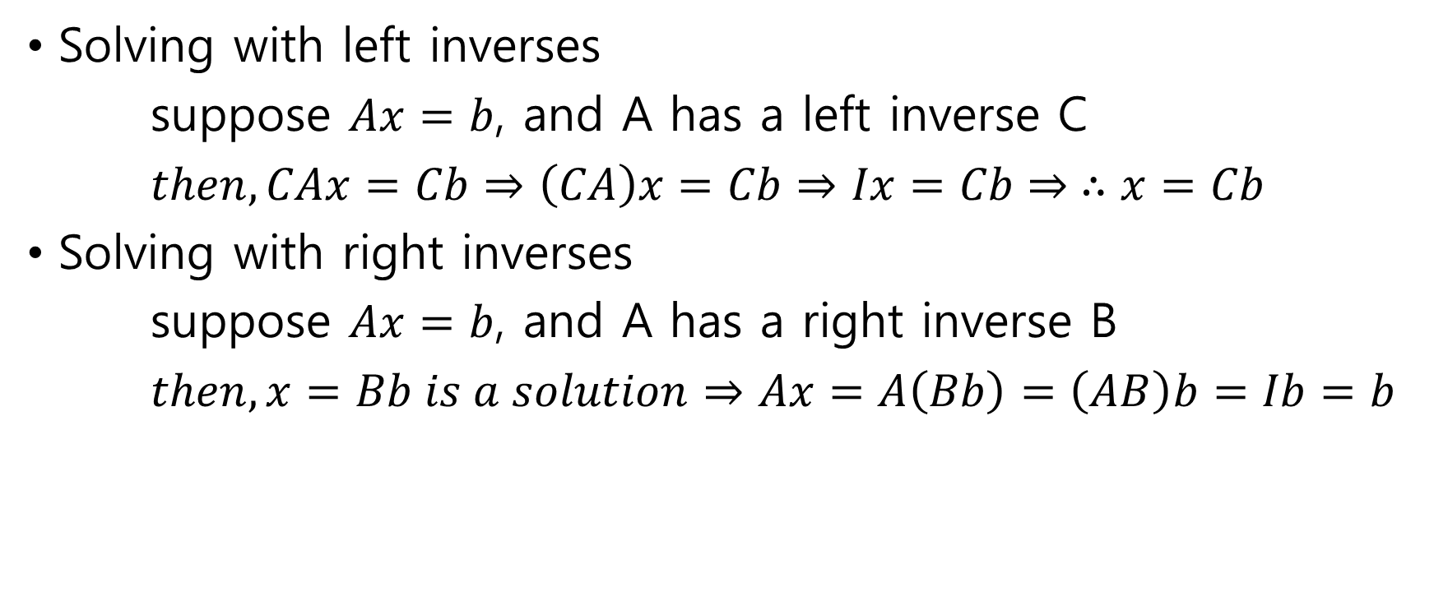
Solving Linear Equations with Inverses
Solving with left inverses
suppose $Ax=b$, and A has a left inverse C
$then, CAx=Cb⇒\left(CA\right)x=Cb⇒Ix=Cb⇒ ∴x=Cb$
Solving with right inverses
suppose $Ax=b$, and A has a right inverse B
$then, x=Bb is a solution⇒Ax=A\left(Bb\right)=\left(AB\right)b=Ib=b$

Slide 5
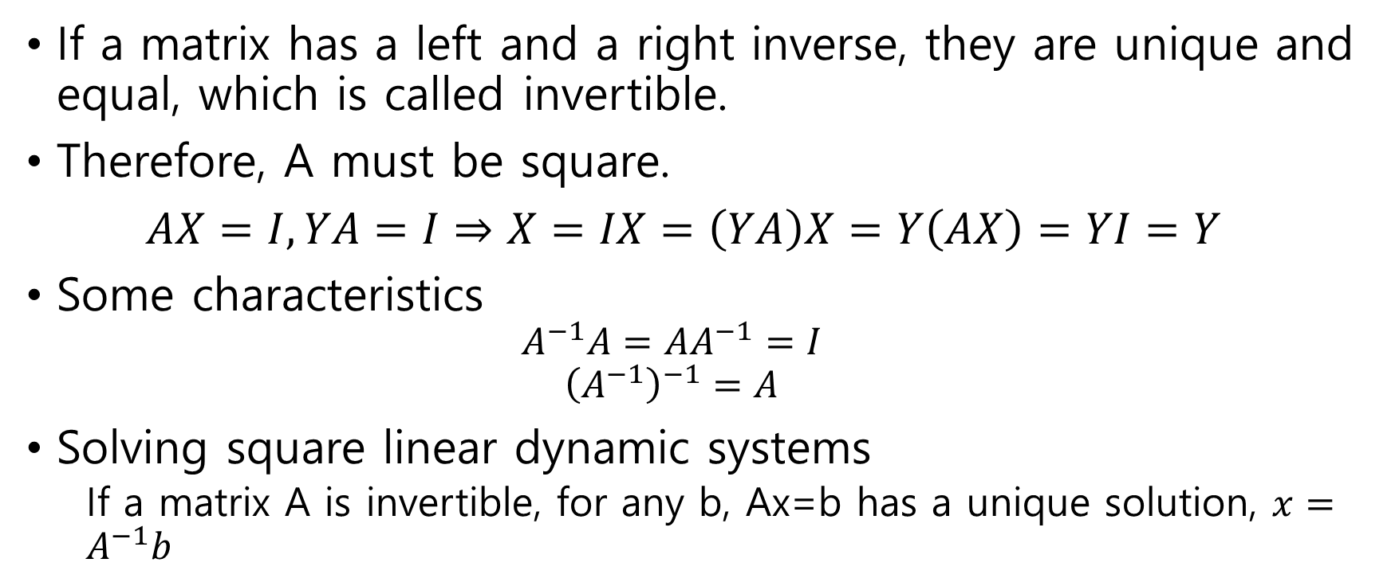
Inverse
If a matrix has a left and a right inverse, they are unique and equal, which is called invertible.
Therefore, A must be square.
$AX=I, YA=I⇒X=IX=\left(YA\right)X=Y\left(AX\right)=YI=Y$
Some characteristics
$$A^{−1}A=AA^{−1}=I$$
$${\left(A^{−1}\right)}^{−1}=A$$
Solving square linear dynamic systems
If a matrix A is invertible, for any b, Ax=b has a unique solution, $x=A^{−1}b$

Slide 6
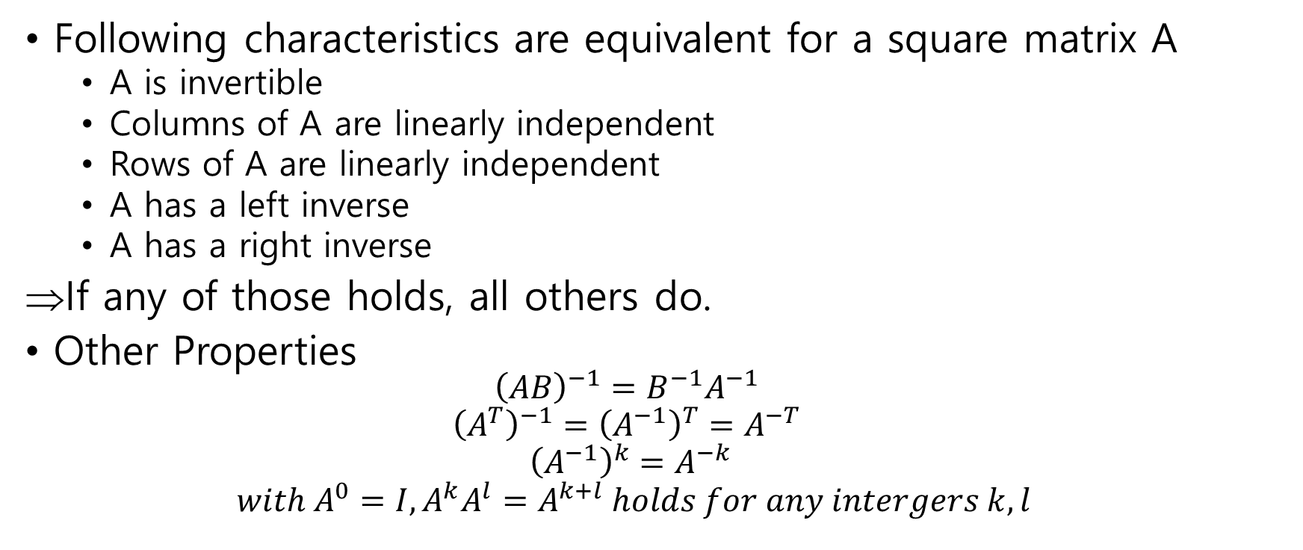
Invertible Matrices
Following characteristics are equivalent for a square matrix A
A is invertible
Columns of A are linearly independent
Rows of A are linearly independent
A has a left inverse
A has a right inverse
If any of those holds, all others do.
Other Properties
$${\left(AB\right)}^{−1}=B^{−1}A^{−1}$$
$${\left(A^{T}\right)}^{−1}={\left(A^{−1}\right)}^{T}=A^{−T}$$
$${\left(A^{−1}\right)}^{k}=A^{−k}$$
$$with A^{0}=I, A^{k}A^{l}=A^{k+l} holds for any intergers k,l$$

Slide 7
Triangular Matrices
Lower triangular matrix L with nonzero diagonal entries is invertible
If writes Lx=0 as
Likewise, upper triangular R with nonzero diagonal entries is also invertible

Slide 8
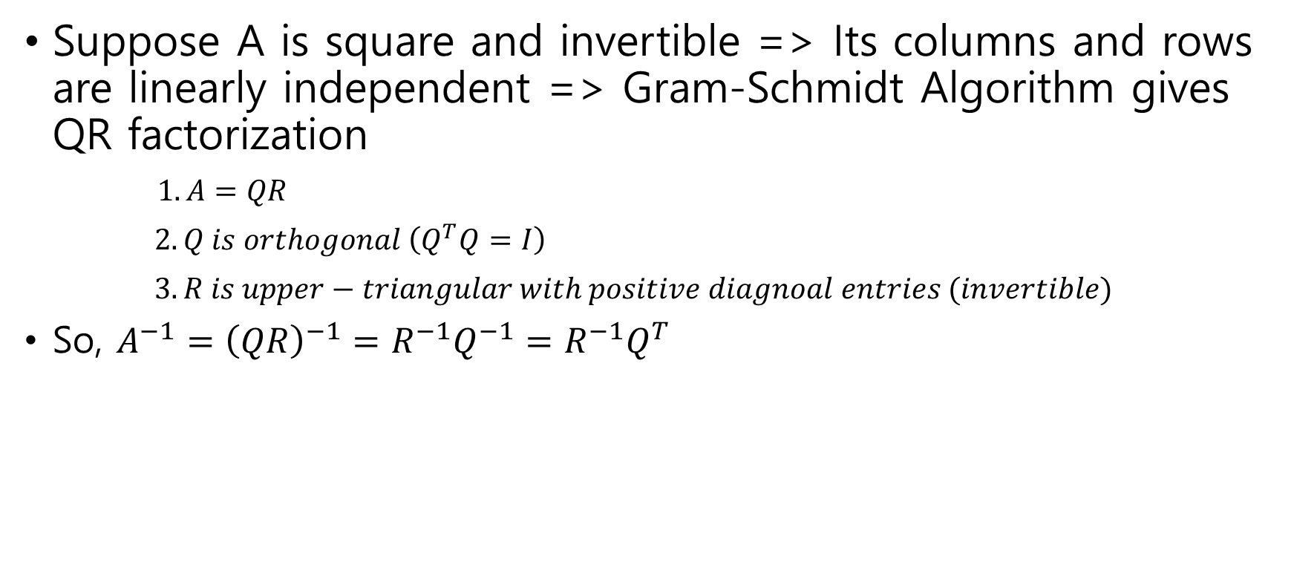
Inverse via QR factorization (★)
Suppose A is square and invertible => Its columns and rows are linearly independent => Gram-Schmidt Algorithm gives QR factorization
$1.A=QR$
$2. Q is orthogonal \left(Q^{T}Q=I\right)$
$3. R is upper−triangular with positive diagnoal entries (invertible)$
So, $A^{−1}={\left(QR\right)}^{−1}=R^{−1}Q^{−1}=R^{−1}Q^{T}$

Slide 9
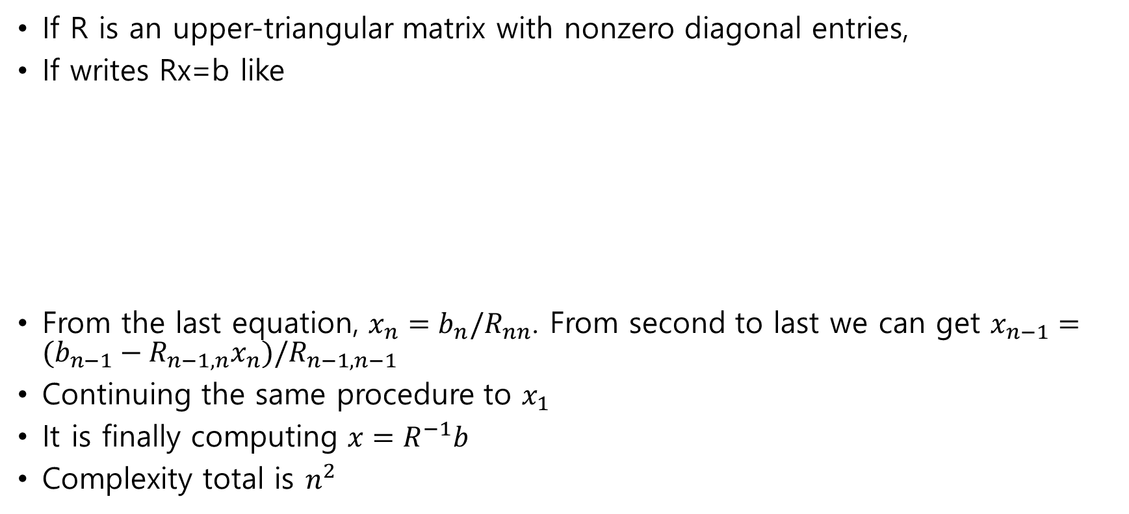
Solving Linear Equations – Back Substitution
If R is an upper-triangular matrix with nonzero diagonal entries,
If writes Rx=b like
From the last equation, $x_{n}=b_{n}/R_{nn}$. From second to last we can get $x_{n−1}=(b_{n−1}−R_{n−1,n}x_{n})/R_{n−1,n−1}$
Continuing the same procedure to $x_{1}$
It is finally computing $x=R^{−1}b$
Complexity total is $n^{2}$

Slide 10
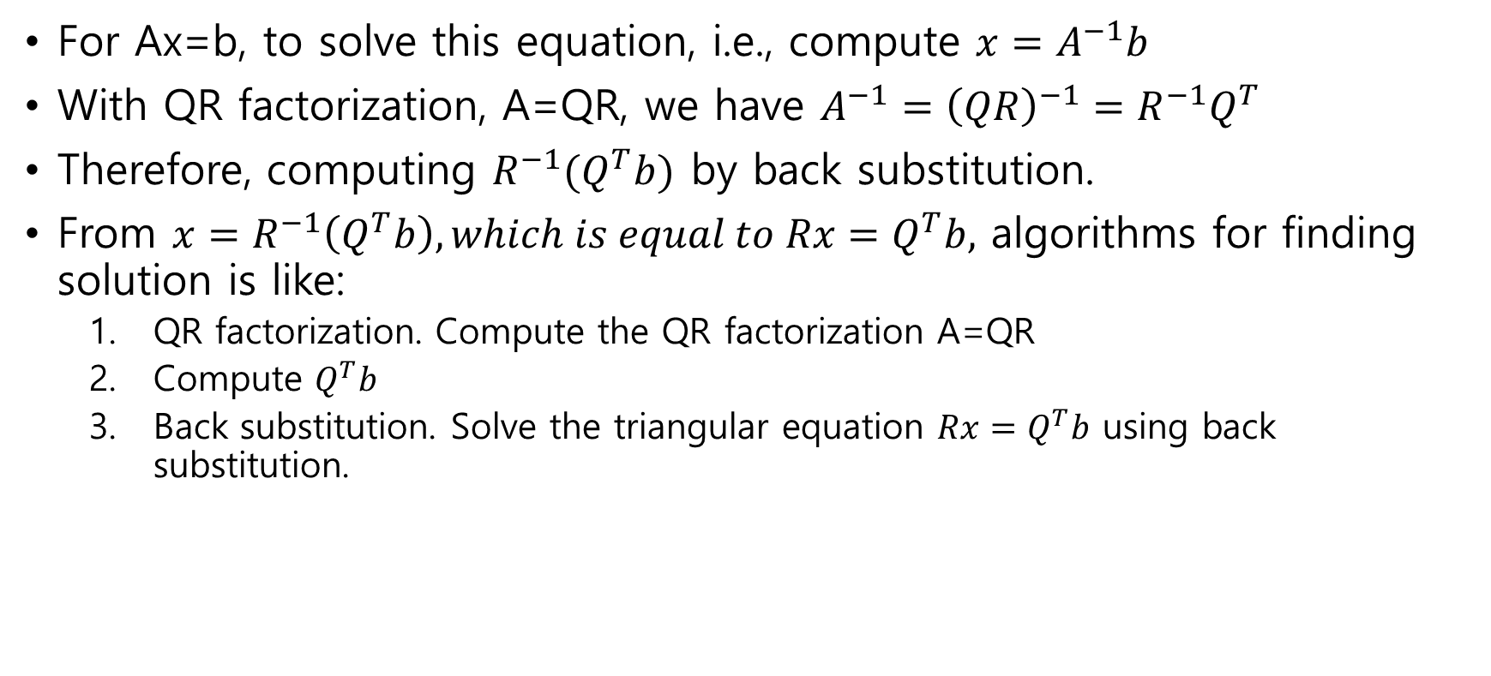
Solving Linear Equations – QR factorization
For Ax=b, to solve this equation, i.e., compute $x=A^{−1}b$
With QR factorization, A=QR, we have $A^{−1}={\left(QR\right)}^{−1}=R^{−1}Q^{T}$
Therefore, computing $R^{−1}(Q^{T}b)$ by back substitution.
From $x=R^{−1}\left(Q^{T}b\right), which is equal to Rx=Q^{T}b,$ algorithms for finding solution is like:
QR factorization. Compute the QR factorization A=QR
Compute $Q^{T}b$
Back substitution. Solve the triangular equation $Rx=Q^{T}b$ using back substitution.

Slide 11

Solving Multiple Cases at once
For $Ax_{i}=b_{i}, \left(i=1, 2, …, k\right), with A is invertible,$
Carry out QR factorization once ($A^{−1}={\left(QR\right)}^{−1}=R^{−1}Q^{T}$)
For i = 1, 2, … , k, solve $Rx_{i}=Q^{T}b_{i}$ through back substitution.

Slide 12

Pseudo-Inverse
For Gram matrix, which satisfies $A^{T}A=I$, if A has independent columns, $A^{T}A is invertible, and vice versa.$

Slide 13
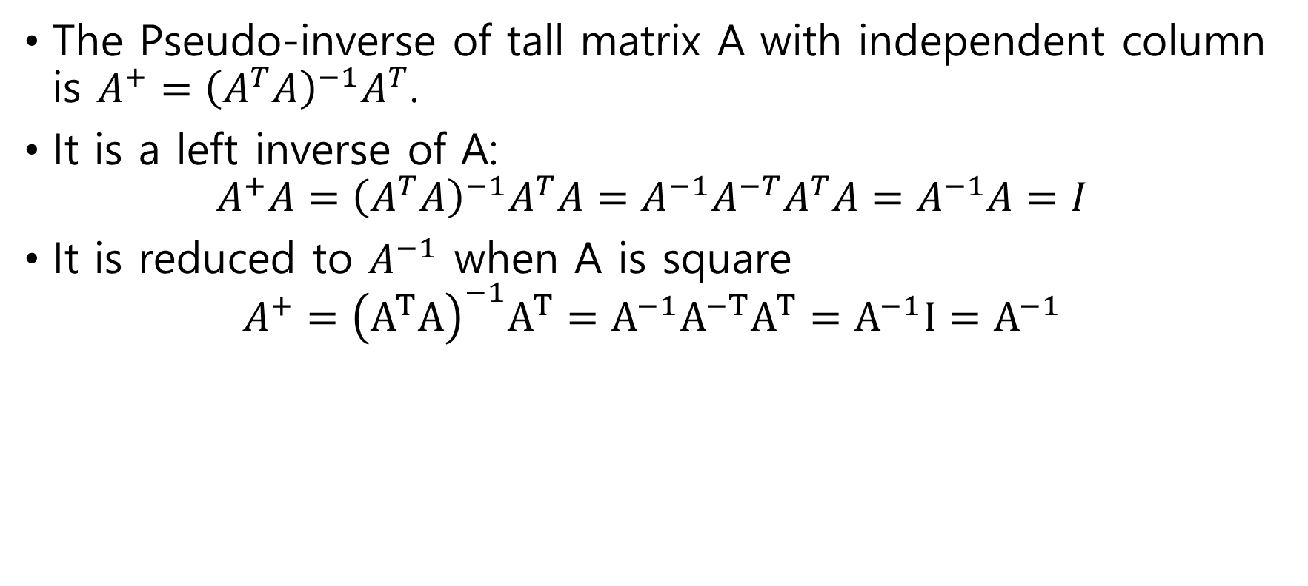
Pseudo-Inverse of tall matrix
The Pseudo-inverse of tall matrix A with independent column is $A^{+}={\left(A^{T}A\right)}^{−1}A^{T}$.
It is a left inverse of A:
$$A^{+}A={\left(A^{T}A\right)}^{−1}A^{T}A=A^{−1}A^{−T}A^{T}A=A^{−1}A=I$$
It is reduced to $A^{−1}$ when A is square
$$A^{+}={\left(A^{T}A\right)}^{−1}A^{T}=A^{−1}A^{−T}A^{T}=A^{−1}I=A^{−1}$$

Slide 14
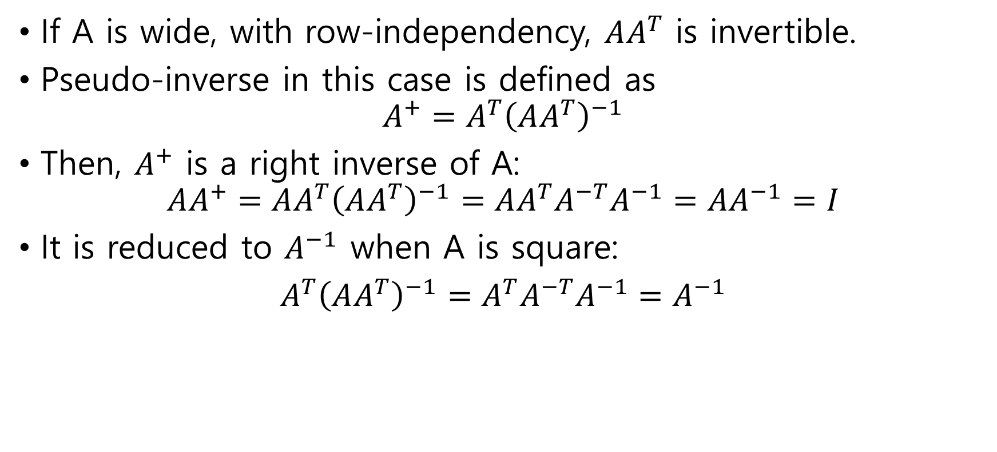
Pseudo-Inverse of wide matrix
If A is wide, with row-independency, $AA^{T}$ is invertible.
Pseudo-inverse in this case is defined as
$$A^{+}=A^{T}{\left(AA^{T}\right)}^{−1}$$
Then, $A^{+}$ is a right inverse of A:
$$AA^{+}=AA^{T}{\left(AA^{T}\right)}^{−1}=AA^{T}A^{−T}A^{−1}=AA^{−1}=I$$
It is reduced to $A^{−1}$ when A is square:
$A^{T}{\left(AA^{T}\right)}^{−1}=A^{T}A^{−T}A^{−1}=A^{−1}$

Slide 15
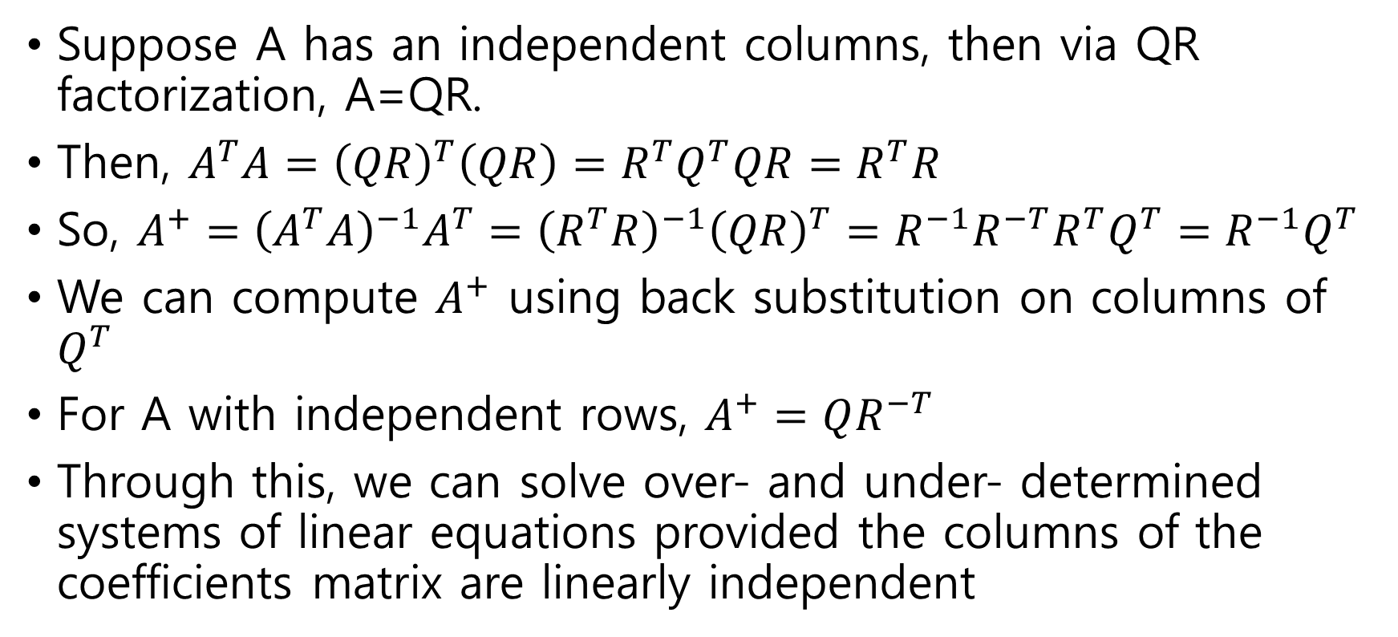
Pseudo-Inverse via QR factorization
Suppose A has an independent columns, then via QR factorization, A=QR.
Then, $A^{T}A={\left(QR\right)}^{T}\left(QR\right)=R^{T}Q^{T}QR=R^{T}R$
So, $A^{+}={\left(A^{T}A\right)}^{−1}A^{T}={\left(R^{T}R\right)}^{−1}{\left(QR\right)}^{T}=R^{−1}R^{−T}R^{T}Q^{T}=R^{−1}Q^{T}$
We can compute $A^{+}$ using back substitution on columns of $Q^{T}$
For A with independent rows, $A^{+}=QR^{−T}$
Through this, we can solve over- and under- determined systems of linear equations provided the columns of the coefficients matrix are linearly independent

